Slide 1


Notes:
SAY: This presentation is provided by Get2College, a non-profit college access organization with a mission to help Mississippi student plan, prepare, and pay for college. EVERYTHING they offer is free, students- know you have people out there who are willing to help. Their website is full of resources, activities, information and where students can book individual appointments or join text messaging (www.get2college.org)
KNOW: On page 3 of the CCR Workbook students can scan the QR code to sign up to receive text updates or ask college questions.
KNOW: If you have any questions about the presentation or facilitation of the presentation, please contact Kierstan Dufour (kdufour@get2college.org).

Slide 2


YOU HAVE
OPTIONS
Private
College
Public
College
Community
College
Notes:
SAY: You have options! There are 15 community colleges, 8 public 4-year universities, and 7 private 4-year universities in the state of MS.
KNOW: A good talking point here is to discuss how you can still be in MS, and be far from home. Or you can pretty much find a college as close as an hour to you.
KNOW: A fun activity before you present this slide is to ask the students if they know how many colleges are in Mississippi OR how many community colleges MS has OR can they name all 8 public colleges in MS.
KNOW: CCR Workbook page 14 has this map and college websites.

Slide 3
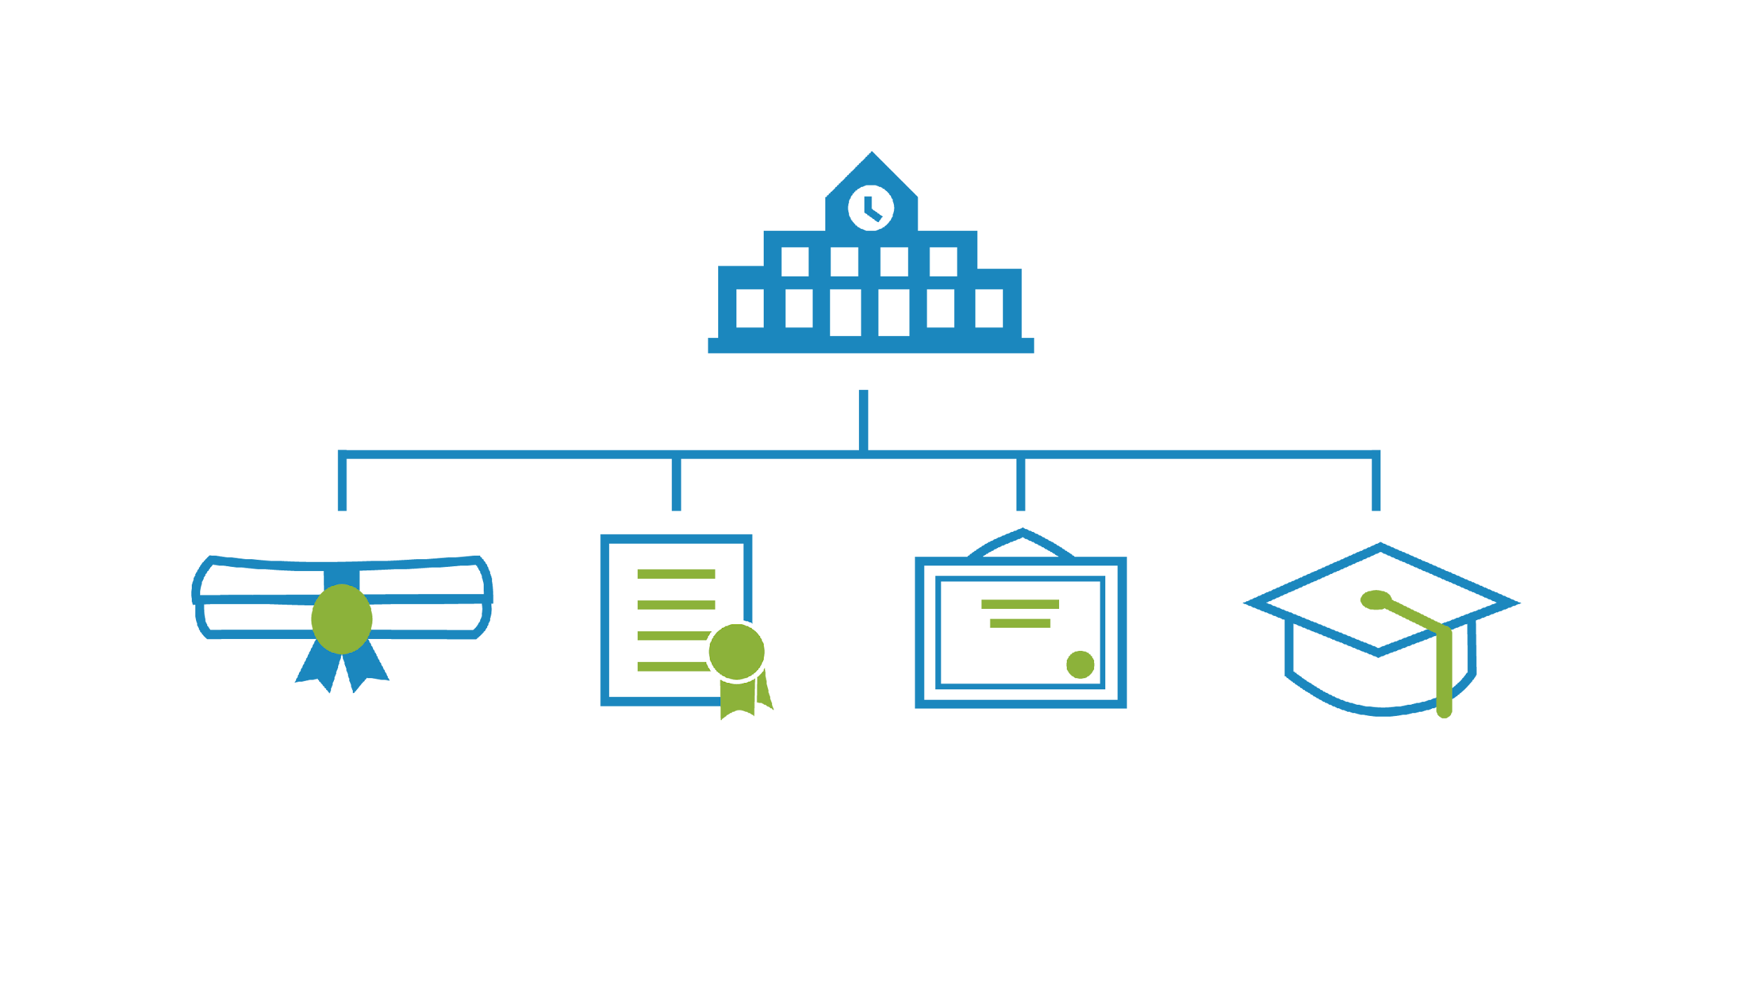
YOU HAVE
OPTIONS
Career &
Technical
Certificate/
Credential
Associate
Degree
Bachelor’s
Degree
Notes:
SAY: A Certificate can be earned through a technical program at a junior college or technical school and is typically shorter than earning an Associate’s degree. Even if you go directly to the workforce, some jobs may require that you become certified in particular skills and may even send you to school for those certifications.
SAY: An Associate’s degree, often completed in two years or less, can be in a specific trade or technical skill, or could be equivalent to the first 2 years of an academic course of study with plans to transfer to a university or college. ​
SAY: A Bachelor’s degree is earned at a 4-year college or university. It is important to understand that the higher the level of education, the higher the earning potential.​
KNOW: CCR Workbook Page 7 relates to this slide and has a reflective activity and resource for determining college major.

Slide 4

FIND YOUR
COLLEGE FIT
2-year or 4-year
Programs Offered
Campus Resources
Affordability
Size/Student-to-faculty ratio
Location & Housing
Extracurricular Activities
Notes:
SAY: YOU have a choice on where you go to college and you want to find the college that is the right fit for you. Fit is not where your parents went, or where your friends are going or not the place that cost the least. Fit is about finding the right school that meets your academic, social, and financial needs.​ What kind of school interests me? Public or Private, Religious Affiliated, Military Academy, or an HBCU which is a Historically Black College or University.​
Each type of college presents a different experience. Not all colleges are the same. For example, the age of the population at a university will be different than the community college campus, b/c at a university, you will have juniors and seniors, masters level students and doctoral students. OR at an HBCU, you have an environment built on a rich African-American heritage, OR at a religious affiliated school you may be required to take faith-based classes as a part of the curriculum.​
Where is the school located? Your ability to embrace the college experience will be dependent on your independence from your parents. Studies show that students that live on campus during their first 2-3 years of college, have a higher success rate, graduate on time, and stay in school more than those who do not live on campus. Because living on campus is a huge part of the college experience, it is important to understand what you are looking for in the area surrounding the campus. Is it urban, suburban, rural? ​
What are the admission policies? Is it a competitive admissions process, or have I already met the requirements with my GPA and ACT score?​
How much does it cost? How do they award financial aid? We’ll talk about this a little later in the presentation. Financial aid might be a big factor for your final decision, but at the beginning of your senior year, you will not have enough information to make a decision based on financial aid. Therefore, it is important to identify other factors that will make the college a good fit. ​
What is the size of the school? You might need a small campus or some of you might want a large campus with lots of diversity. ​
​
What special opportunities does the school offer ME? Getting involved on a college campus helps you meet people and important administrators. You might want to study abroad, or maybe you want top-notch research opportunities in medicine, or hands on experience with an archeological dig. Each college has something they are proud to offer the students…something distinctive. Find out what these distinctive strengths are for each college or university.
KNOW: CCR Workbook pages 8, 9, 15, 16, & 17 have interactive list making and activities to help students research, reflect, and create their college list.
KNOW: CCR Workbook page 9 has information about selective colleges and the language students needs to know about this unique type of admission process.
KNOW: Activity you could do with your student is build a college (found here).

Slide 5


Talk to college reps
Attend college fairs
Make campus visits
Career Exploration
Notes:
SAY: Don’t miss your high school college fair. Attending a college fair will give you the opportunity to meet with representatives from different colleges and to gather materials that will give you a better idea of what each school would be like. ​
​
The BEST way to get a feel for whether a college is right for you is to MAKE THE CAMPUS VISIT!​
​
If you plan a campus visit; we suggest taking your parents or family with you and visit when students are on campus. You may want to visit when it is convenient for you and your parents such as over the Thanksgiving or Christmas break. But students aren’t on campus so you miss out on really getting a feel for the campus. And, let me put it out there: Tailgating is NOT a campus visit. Football games are fun, but you should make a formal campus visit and learn more about the college.​
​
Check the website or call the college admissions office to find out about campus visit days.​
A great campus visit should INCLUDE:​
-Meeting with an admissions RECRUITER and taking a tour,​
Visit the residence halls where you will spend a lot of time​
-Talk with current STUDENTS, ​
-Eat in the CAFETERIA and​
-And, if possible, sit in on a CLASS. ​
KNOW: CCR Workbook pages 15, 16, &, 17 have information about Do’s & Dont’s of College fairs, 20 questions to ask college representatives, and a college fair tracking worksheet.
KNOW: CCR Workbook page 18 has a campus visit photo scavenger hunt activity.
KNOW: CCR Workbook page 10 has a short personality assessment that links to page 11- Mississippi largest employers and in-demand & growth jobs specifically in Mississippi.
KNOW: CCR Workbook pages 6 & 19 have terminology commonly used in college admissions conversations.

Slide 6


APPLICATIONS
Public MS Schools
High school transcript
Application fee or fee waiver
ACT/SAT scores
Other colleges may need
Letter of recommendation
Essays
Resume
Interview
Applications open as
early as June 1st for
high school seniors.
Notes:
SAY: Seniors if you haven’t already begun REQUESTING admission APPLICATIONS from the colleges you are considering, you need to do this NOW! Do NOT wait to complete the admission applications or you might miss out on certain scholarships! The AVERAGE student in the US will apply to 3-5 schools. Research shows that students that apply to 3 schools have a higher percentage of going off to college. The above average student will apply to more. Please don’t pick one or two colleges because you are limiting your opportunities!​
We like to tell students to apply to reach schools and match/fit schools. ​
Reach schools are schools that might be a REACH for you in some way…it may be far from home, high admissions standards, or it may be really expensive;​
Match school are the ones that are an easy match - where you KNOW you can GET IN and PAY but it’s not your first choice.​
The likely schools are the ones where you are most likely to attend.​
Find out what is required in the admissions process for each college you are interested in. For community colleges and Public Universities- you may only need your high school course requirements on your transcript, a minimum GPA and minimum ACT or SAT. ​
But for a private college or an honors program, there may be other steps in the process such as Essays or Letters of Recommendation. The school may even require an interview. For the more competitive schools, there may be more steps in the process.​
​Some universities require application fees. It’s important to know what method of payment they require so you can make those arrangements. If you are eligible for free or reduced priced lunch, ask your counselor about getting a fee waiver for the application. Make sure you have sent the schools all the documents they require so your application can be complete. You can’t get scholarships or financial aid unless you have been accepted for admission!​
Some college applications will require that you submit a resume, essays, letters of recommendation or may even require an interview.​
KNOW: CCR Workbook pages 32 & 33 have college application information page and activity to keep track of application information and checklist of to do items.
KNOW: An activity you could do with your students is the GPA game (found here).
KNOW: CCR Workbook page 24 is writing a personal statement activity.

Slide 7
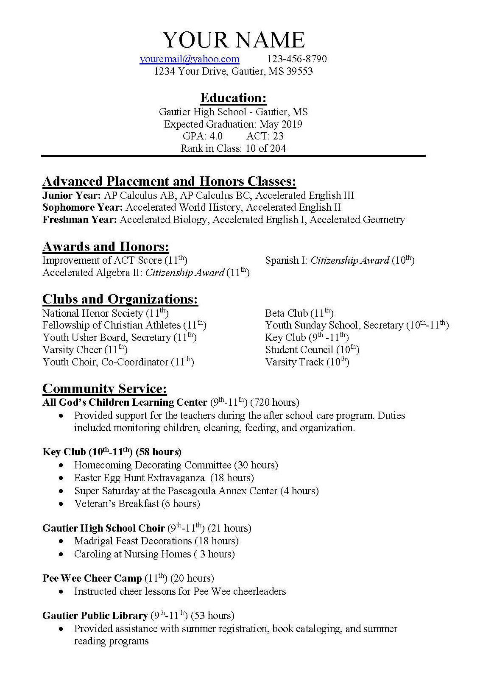
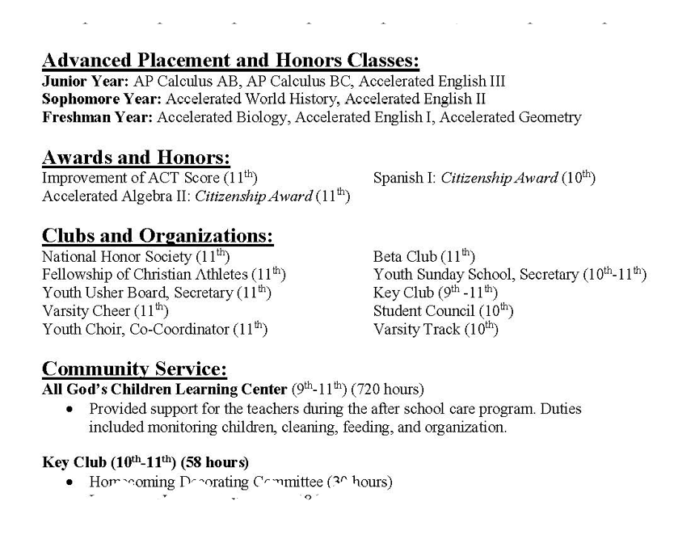
RESUME
Notes:
SAY: Every resume will be different because we all have different involvement and like to do different things. Highlight your brag points- Advanced classes, leadership, all the community service hours. Resumes are working documents- never done! Keep adding as you become more involved with things.
KNOW: CCR Workbook pages 20-22 are college resume building activities and examples.
KNOW: Here are additional academic resume resources including worksheets and templates (found here).

Slide 8

HOW DO COLLEGES
USE MY SCORES?
Determine Admissibility
Scholarship Money
Class Placement
Notes:
SAY: WHAT DO COLLEGES DO WITH ACT SCORES? Most students don’t realize how colleges use their ACT scores. There are 3 main functions:​
​
Schools use ACT scores for college admission - Admissions offices will view your score as an indicator of your potential to succeed at their school. Example: If your ACT score is a 20 and you apply to Tulane University in New Orleans, they most likely will not consider you for admission because, based on your score, the course work would be too difficult.​
​
Colleges use ACT scores for scholarship money- Most colleges have academic merit-based scholarships that depend on ACT scores and GPA to reward students’ academic performance with scholarship dollars. Every college has different requirements for awarding scholarships based on ACT scores. Make sure to check with the colleges you are considering to know what ACT score you need to get the scholarship dollars there.
Colleges also use ACT scores for Class placement. Schools have required scores to enter regular freshman level English and Math classes. If your overall score was ​
an 18, but you scored a 16 in the English section then you might have to take a remedial English class. That class will not count towards graduation and you still have to pay for it. It’s important to be aware of, not only your overall score, but also your sub-scores. ​
KNOW: CCR Workbook pages 34- 41 provide detailed information on how ACT scores are used and explains about cost, test dates, superscores, and test taking tips/resources.

Slide 9
ADMISSION REQUIREMENTS
For the eight 4-year universities in Mississippi
3.2 GPA
16+
18+
NCAA
minimum
ACT®
ACT®
National Collegiate
Athletic Association
2.5 GPA
2.0 GPA
Complete high school grad requirements
minimum or
NCAA Division I standards for student athletes who are “fill qualifiers” or “academic redshirts” are accepted as equivalent to the admission standards established by the Board.
minimum or
top 50% of class
minimum or
top 50% of class
CPC
Complete high school grad requirement
Complete high school grad requirement
College Preparatory
Curriculum
CPC
CPC
College Preparatory
Curriculum
College Preparatory
Curriculum
Notes:
SAY: Mississippi has 8 public 4-year-schools, 7 private schools, 15 community colleges. Review about GPA- differences between core and cumulative, how GPA is calculated. Give overview of admissions requirements at Univ. and CCs.
KNOW: CCR Workbook page 28 has this chart and more details about the alternatives if they don’t meet these admissions requirements for a 4-year college.
KNOW: CCR Workbook pages 26 & 27 is information and reflection on types of GPA and why it matters in admission to college. Page 27 is activity for students to calculate their own GPA.
KNOW: CCR Workbook pages 29 has the College Prep Curriculum.
KNOW: CCR Workbook page 30 has information about ACT WorkKeys Career Readiness Certificate for students looking to enroll in a trade program.
KNOW: CCR Workbook page 31 has information about NCAA eligibility for student athletes.

Slide 10
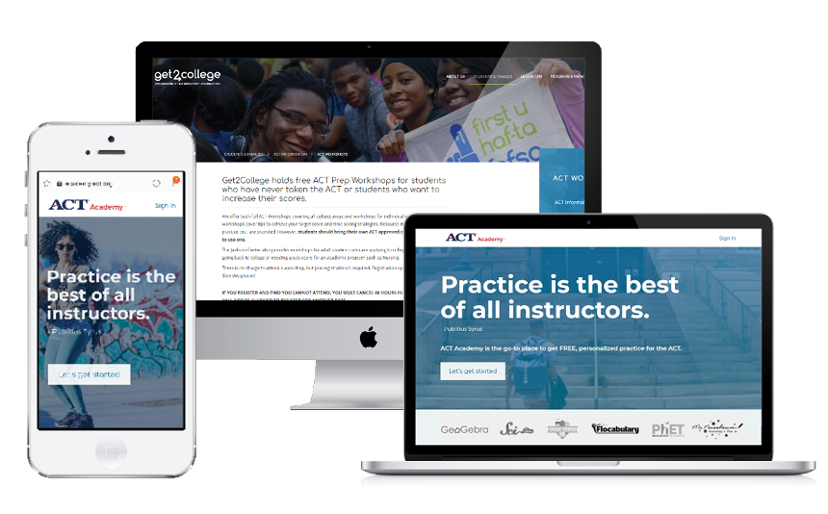

STUDY TOOLS
For the ACT
Notes:
SAY: There are plenty of resources available for studying for standardized tests both free and can purchase. Test Information Release: encourage students to utilize to get their old test and answers back to study from (select national test dates). Get2College resources: ACT workshops, tips videos, website resources.
KNOW: CCR Workbook pages 36-41 are short ACT prep tips and resources.

Slide 11

THE COST OF COLLEGE &
HOW TO PAY FOR IT
Notes:
KNOW: Transition slide into how much college costs and how to pay for it. This information can be used for both juniors and seniors – juniors can use this to start preparing earlier for the “payment” part of the college planning process. Juniors and seniors can benefit from knowing more about the financial pieces so that they can do their research for the colleges they are interested in applying to.
KNOW: CCR Workbook page 42 has terminology commonly used around paying for college.

Slide 12


COST OF ATTENDANCE
Net Price Calculator
$14,774
Avg. annual
Cost of attendance
$26,547
Avg. annual
Cost of attendance
$3,410 - $5,044
Annual tuition (2024-2025)
$7,692 - $10,202
Annual tuition (2024-2025)
Community Colleges
In Mississippi
Public Universities
In Mississippi
Notes:
SAY: (Explain what Cost of Attendance Is) – it is more than just tuition. Cost of Attendance is an estimate of how much a student might have to spend during their time on that campus. This DOES include things such as tuition, meal plans, housing – but think through expenses beyond tuition (haircuts, gas, sorority fees).
Cost of Attendance (COA): The COA is the total estimated cost of attending a college and includes tuition, fees, housing, meals, books and other living expenses.
KNOW: CCR Workbook page 52 has comparing cost activity that includes having students calculate 3 colleges COA.

Slide 13
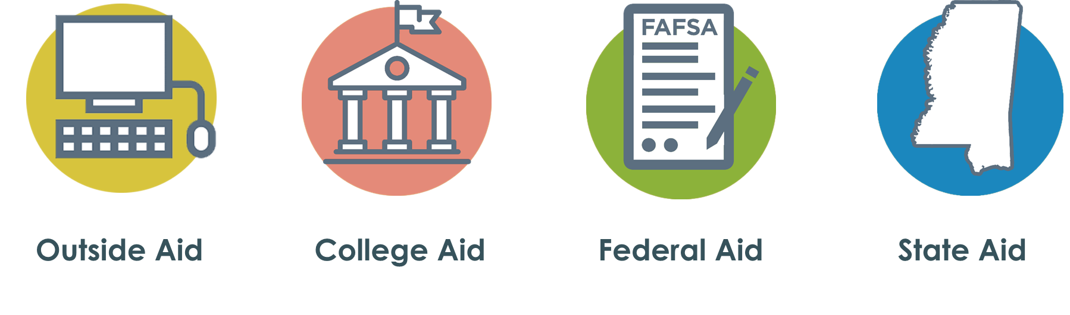
Notes:
SAY: We’ve talked about getting admitted to college, now let’s talk about how to pay for it. Every student would love a chance to get free money for college, right?? We know it’s not as easy as just pulling $20,000 out of your own pocket. There are 4 sources of scholarships and financial aid that a student can potentially pull from:
​
Outside Scholarships – Local community organizations/businesses, big corporations, clothing brands, etc.
College Aid - Money that comes directly from the college​: Academic Merit scholarships, leadership-based scholarships, departmental scholarships, athletic scholarships, etc.
Federal Aid – which includes grants, loans and work​ study
State Financial Aid – some of which is based on academic merit and others on financial need ​

Slide 14

OUTSIDE AID
Counselor/School Website
Online Databases
Local businesses
Community Organizations
Newspaper
Scholarship Search tool (Resource on our website)
Notes:
SAY: The first is OUTSIDE AID. There are scholarships for every kind of student. The scholarship criteria could be academic achievement, community service, athletic, musical, artistic ability, or even your interests. Many private scholarships do not even require an ACT score. These scholarships could also range in the amount awarded, but outside aid normally means that the money can follow you to any college you plan to attend!
​
But you can’t find scholarship dollars without looking. One of your best sources for knowing about outside scholarships will be your high school counselor. You may have a bulletin board or website at your school where these are listed. Also check out the Get2College website, get2college.org/scholarships, where they have a scholarship search tool where a list of both Mississippi-based and national scholarships can be filtered through and applied for. Many scholarships are not posted until the fall of your senior year, but deadline approach quickly and could pop up as early as December.
​
Search for scholarships using free online databases, such as Big Future or Fastweb.
**Juniors – you can begin researching these scholarships as early the beginning of your junior year to get a bit of a head start, although you will not start applying for these until your senior year.
KNOW: CCR Workbook page 43 has details and examples of Outside Aid.

Slide 15

COLLEGE AID
Merit-based Scholarships
Academic Merit
Leadership
Sports
Arts/Music
Community Service
Need-based Grants/Scholarships
Notes:
SAY: Scholarships from the colleges and universities to which you are applying can be your best source of financial aid. When we think of scholarships for colleges, you might think of scholarships based on your ACT and your GPA. But there are many other merit scholarships such as for music, art, theatre, athletics, leadership, and community service. And there may be scholarships based on financial need that, if eligible, you could receive from the college. This money is gift-aid – money you do not have to repay, just like merit-based scholarships.​
​
For some schools the application for admission is the scholarship application, but many colleges will have separate application for scholarships, or even interviews, portfolios or auditions. You want to make sure you are applying for all scholarships AND meeting all of the deadlines. Some colleges require you to complete a scholarship application after you complete the admission applications in the fall of your senior year – many schools open that application on August 1. This is where a lot of your “free money” - or money you do not have to repay - comes from! Biggest piece of advice – make sure you meet ALL deadlines!!
The best place to find these scholarship opportunities, requirements, and deadlines is on the college’s website. But if you have trouble finding this information call, email, or direct message that college’s admissions recruiter and they can get you all of this information- it’s their job!

Slide 16
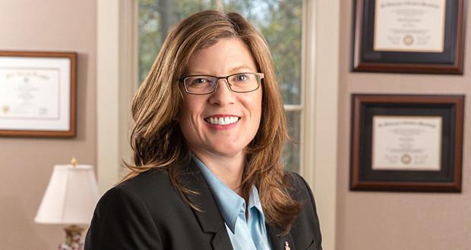

PHI THETA KAPPA
“Students in Mississippi can't afford to pass up an opportunity to join Phi Theta Kappa”
Lynn Tincher-Ladner
President & CEO
Phi Theta Kappa
*Transferable hours may vary between
colleges to receive transfer scholarships
Notes:
SAY: If a student attends a community college, they can join Phi Theta Kappa, an honors society. Eligible students will receive an invitation if membership requirements are met—typically a 3.5 GPA and 12 credit hours. Scholarships are available to high-achieving community college students who plan to transfer to a four-year college or university. Phi Theta Kappa members are eligible for transfer scholarships at Mississippi four-year colleges and universities - and these scholarships vary at each institution.

Slide 17


FEDERAL AID
Federal Aid = FAFSA, fafsa.gov
Types of Federal Student Aid:
Pell Grant ($7,395/year for 24-25)
Work-Study (typically around $2,000/year)
FSEOG (grant)
Loans ($5,500)
The FAFSA will be available on December 1, 2024 for the class of 2025 and it will be based on the prior prior year’s taxes
Notes:
SAY: It is important to complete the Free Application for Federal Student Aid (FAFSA), the application used to help determine student eligibility for financial aid. You can file your senior year. Make sure to file the FAFSA before your college’s priority filing deadline to qualify for the most money.
​
The FAFSA, is not just required for federal grants, it is also used for some of the Mississippi grants. AND colleges and universities may also use the FAFSA for their institutional need-based financial aid. So even if you don’t qualify for federal grants, you might qualify for the college or university grants! ​
​
When you complete the FAFSA, the confirmation page will tell you if you might be eligible for Federal Pell. The college makes the award based on the FAFSA calculation.​
The current(24-25 academic year) maximum Pell Grant amount is $7,395.
**NOTE: The 25-26 FAFSA for the class of 2025 will not open until December 1.
For Juniors: The FAFSA application can typically be completed as early as by Oct. 1st of your senior year of high school. Be aware that while you cannot fill out the FAFSA now, there are many other things you can begin doing to prepare for college.
KNOW: CCR Workbook pages 44- 47 provide details on the FAFSA completion, federal aid and what to do after the FAFSA.
KNOW: Federal Student Aid offers a FAFSA Prototype site that could be an activity juniors do and complete a mock FAFSA.

Slide 18
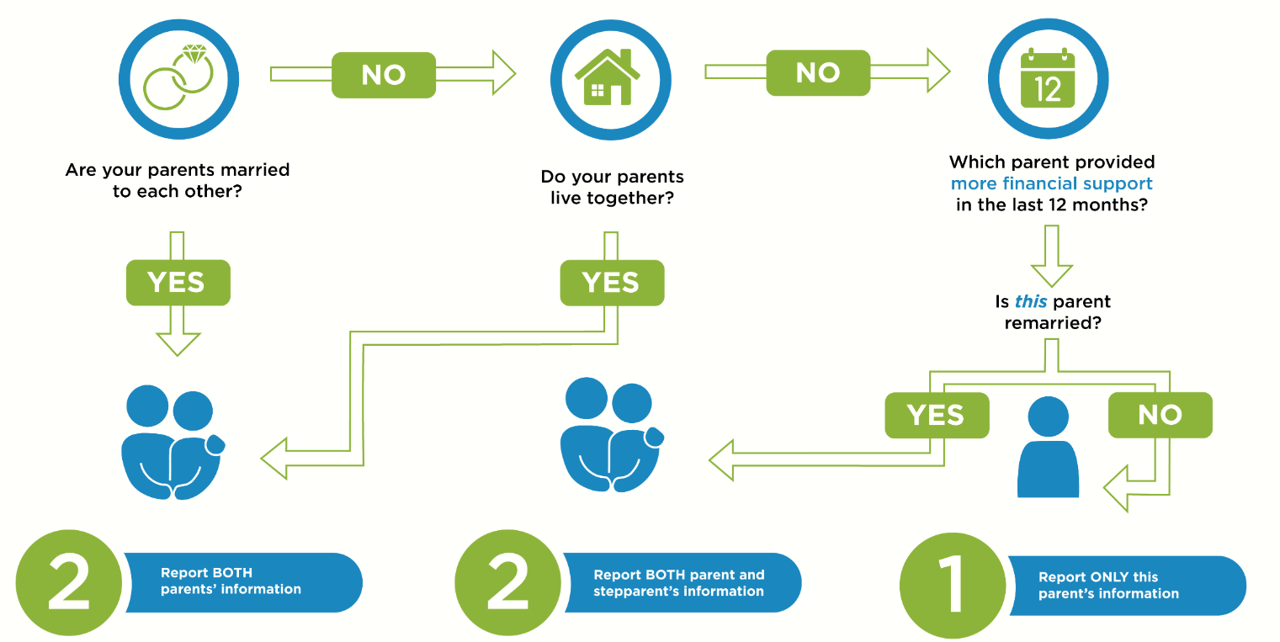
FEDERAL AID
Who is the contributor to my FAFSA?
Notes:
SAY: The FAFSA may require more than the students information is the student is dependent as determined by the personal circumstance questions on the form. Parents may need to contribute to a students FAFSA their financial information which will be transferred directly from Federal Student Aid once consent is given. It is important for you to know who all will be expected to be contributors on the FAFSA before it opens to allow for time to contributors to create a unique username and password (FSA ID) for log into the invite that is sent from the students.
Use this flowchart to help determine which parent(s) are contributors for dependent students.
Remember, grandparents, legal guardians, widowed stepparents, foster parents, siblings are NEVER contributors unless they have legally adopted the student.

Slide 19
LOAN TYPES
DIRECT
SUBSIDIZED
LOANS
(Undergraduate)
6.53%
DIRECT
UNSUBSIDIZED
LOANS
(Undergraduate)
6.53%
DIRECT
UNSUBSIDIZED
LOANS
(Graduate)
8.08%
DIRECT
PLUS
LOANS
(Graduate & Parents)
9.08%
2024-2025 Interest Rates
Notes:
SAY: There are several types of student loans, but remember LOANS must be repaid. Loans are a great source and many students could not go to college without a loan but you should explore all other options first. AND never borrow any more than is absolutely necessary. If a school awards you, for example, $5500 and you only need $2000, then reduce the amount on your award letter and ONLY borrow what you need!​
​
The 3 types of loans are Perkins loans, Federal Direct Student Loans, and loans for your parents called PLUS loans. YOU MUST COMPLETE THE FAFSA to be awarded any federal loan.​
KNOW: CCR Workbook pages 50 & 51 have more details about student loan types, resources to estimate loan amounts, and how a financial aid offer letter works.

Slide 20



MISSISSIPPI FINANCIAL AID
HELP
HIGHER EDUCATION
LEGISLATIVE PLAN
20 ACT
2.5 GPA
IHL CPC
Income
Requirements
FAITH
Fostering Access & Inspiring True Hope Scholarship
US Citizen
Under 25
FAFSA
CPS-Requirements
MTAG
MS TUITION
ASSISTANCE GRANT
15 ACT
2.5 GPA
MESG
MS EMINENT
SCHOLARS GRANT
29 ACT
3.5 GPA
Notes:
SAY: The state of MS provides 4 possible grants for MS high school graduates who plan to attend college in MS to receive. Apply as early as October 1 (of your senior year) at msfinancialaid.org.
MTAG (MS Tuition Assistance Grant) is for students who have a 15 ACT Superscore and a 2.5 GPA
The value is: $500 for Freshman year & Sophomore year
$1000 for Junior year & Senior year
Students who receive maximum Pell Grant ($7,395/year CANNOT get MTAG)
​MESG (MS Eminent Scholar Grant) is for students who have a 29 ACT Superscore or 1290 SAT and a 3.5 GPA
The value is $2500 each year for four years
​
​HELP Grant (Higher Education Legislative Plan) is for students have a 2.5 gpa and at least a 20 Superscore on the ACT. Students must take the IHL college prep curriculum, and meet the income requirements.
The value is: FULL TUITION at any public college or university in MS.
FAITH Scholarship (Fostering Access & Inspiring True Hope Scholarship) is for students who at any time since their 13th birthday have been in foster care through CPS or in a qualified residential facility. Students must be under the age of 25, a US citizen, complete the FAFSA & MAAPP.
The value is: Up to FULL Cost of Attendance + housing during school breaks (where available). There is no deadline.
KNOW: CCR workbook pages 48 & 49 provides more details on each of these grants and checklist of what to do after completing the application for these grants.

Slide 21
MISSISSIPPI FINANCIAL AID
Covers full tuition and required fees at any public school in Mississippi for 4 years or 8 semesters
Special circumstances for private schools
Application deadline
March 31 and additional documents April 30
HELP
HIGHER EDUCATION
LEGISLATIVE PLAN
20 ACT
2.5 GPA
IHL CPC
Income
Requirements
Notes:
SAY: Requirements for the HELP Grant are: 2.5 GPA, 20 ACT Superscore, IHL college prep curriculum, $39,500 or less AGI ($5,000 for each additional sibling under 21).
The award is: full tuition and fee at public college/university for 4 years, private colleges-value of the average IHL tuition and fees applied to aid.
The HELP grant has to be applied for annually, March 31 deadline, and the only time a student can apply for this grant is as a senior in HS or freshman in college.
The HELP Grant can stack with the PELL grant and college scholarships.

Slide 22
MISSISSIPPI FINANCIAL AID
Pays up to FULL Cost of Attendance + housing during school breaks (where available)
Eligibility:
US Citizen
<25 years of age
Fill out the FAFSA
Meet CPS Requirements
Enroll in MS institution for undergraduate credential or degree
Application is the MAAPP
NO DEADLINE
HELP
HIGHER EDUCATION
LEGISLATIVE PLAN
20 ACT
2.5 GPA
IHL CPC
Income
Requirements
FAITH
Fostering Access & Inspiring True Hope Scholarship
US Citizen
Under 25
FAFSA
CPS-Requirements
Notes:
SAY: This is a brand new scholarship for the class of 2022 from the State of Mississippi. It covers the FULL cost of attendance + housing costs during school breaks (when available).
The eligibility requirements are:
US Citizen​
< 25 years of age​
Fill out the FAFSA (if applicable: other federal aid apps)​
Meet one of the following criteria:​
- In legal custody of CPS at any time since age 13​
- In qualified residential facility at any time since age 13​
- Adopted from CPS or qualified residential facility after age 13​
Enroll in MS institution for undergraduate credential or degree​
Important Dates:​
Application opens October 1 annually [MAAPP]​
No deadline​

Slide 23

Students must enroll in and earn
at least 15 credit hours to receive Mississippi Aid
Students will receive aid from only
one state grant program
msfinancialaid.org
Notes:
SAY: Students must take at least 15 credit hours each year to be eligible for state grants. For each grant, students must keep the minimum required GPA of 2.5 for MTAG and HELP and 3.5 for MESG. If not, students have a semester of probation to get GPA back up. All three types of grants are available for 8 semesters as long as apply and renew by the deadline. Students can only receive 1 of the 3 grants.

Slide 24

COLLEGE PLANNING CHECKLIST
JOB- SHADOWING/
INTERNSHIPS
APPLY
ACT
NET PRICE
CALCULATOR
HIGH SCHOOL
RESUME
FAFSA
CONTACT
RECRUITERS
STATE AID
APPLICATION
CAMPUS
VISITS
SCHOLARSHIPS
Notes:
SAY: This checklist is a great take-a-way to do list for seniors and juniors.
The only items on this to-do list that Juniors CANNOT do is apply to college, and complete the FAFSA/State Aid/and Scholarship applications. Encouraging students to get started on this process early is a must!
KNOW: CCR Workbook pages 4 & 5 have a more detailed list for both juniors and seniors.

Slide 25



ACTION STEPS
Sign up for text messaging
Register for ACT Prep
Schedule an appointment with Get2College
Notes:
SAY: Besides the checklist, there are several other action steps that students can take to begin the college-going process. Encourage students to sign up for Get2College’s text messaging program (info on next slide). Also, encourage students to register for Get2College’s virtual ACT prep. All of our resources are free! Lastly if students need assisting in this process they can make an in-person or virtual with a counselor at their local Get2College center.

Slide 26


Text “College”
to
601-996-7015
Notes:
SAY: Sign up for two-way text messaging from Get2College! Receive reminders about when to apply for college and financial aid, as well as tips about admissions, campus visits, and the ACT. The best part? You can text us anytime with questions. Messaging is available for high school students, their parents, or high school counselors. Messaging and data rates apply.

Slide 27

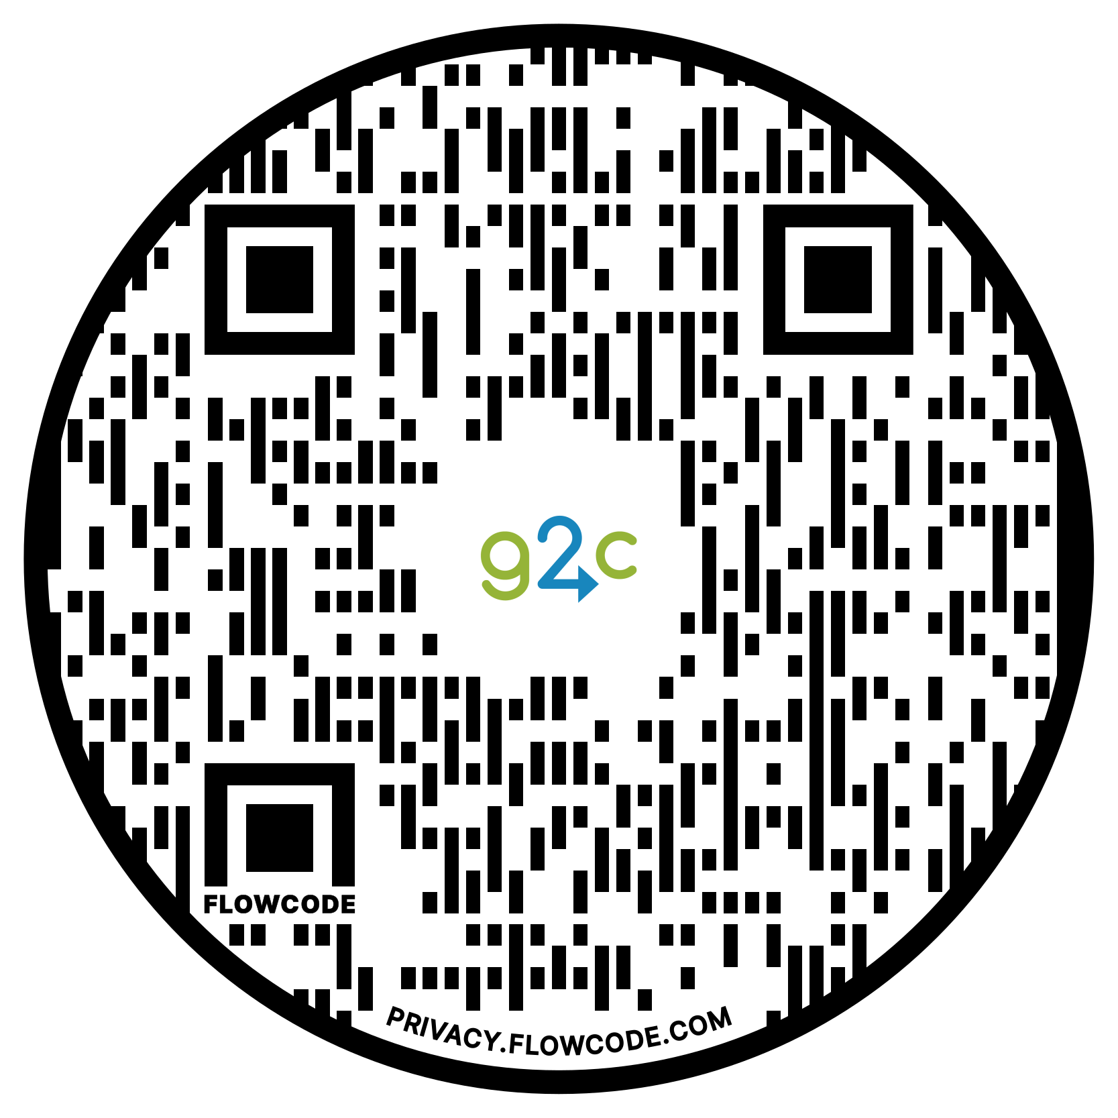

get2college.org
Notes:
SAY: Get2College is a non-profit college access organization whose goal is help students go to college and figure out how to pay for it. For more information visit the QR code to access different resources on the website.

