Slide 1


Taking ACTion on the ACT®
Get2College’s guide to help you ace the ACT®

Slide 2

How do colleges use ACT® scores?
Notes:
There are 3 ways that colleges use ACT scores. Can anyone name them?

Slide 3
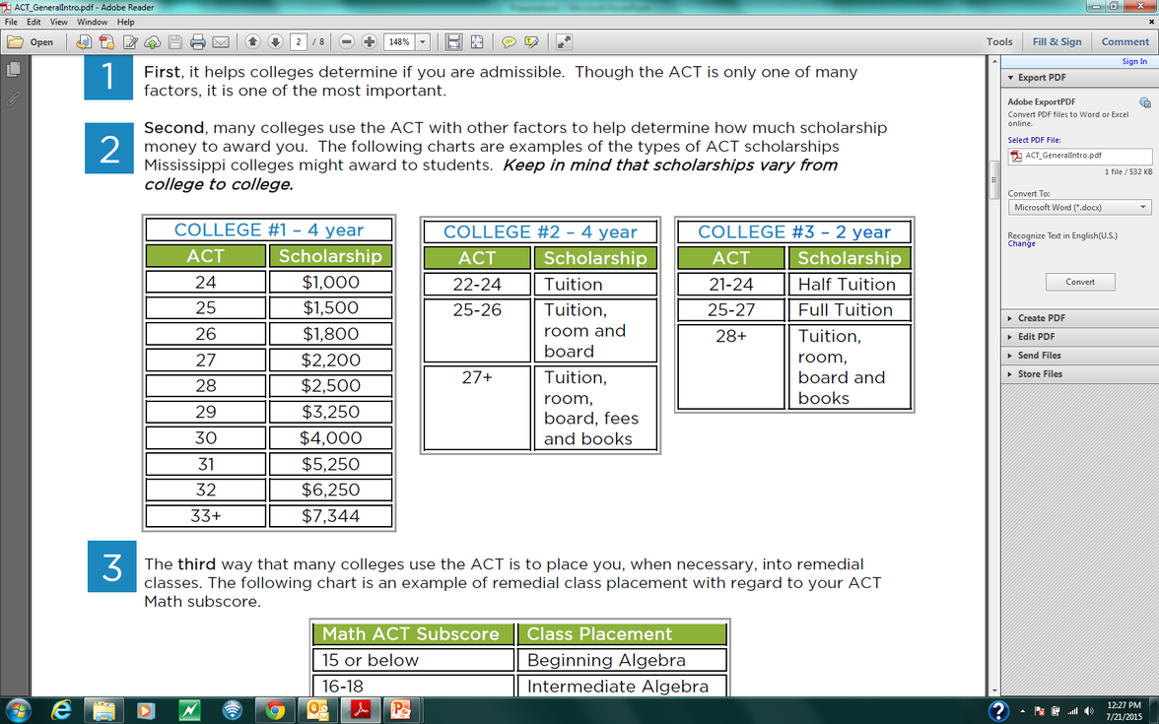

3 Ways Colleges Use ACT® Scores:
1
To determine student admissibility
2
To award scholarship money
3
To determine class placement
Math ACT Subscore | Class Placement
15 or below | Beginning Algebra
16-18 | Intermediate Algebra
19 or above | College Algebra
Notes:
College admissions: some competitive schools (for example, Vanderbilt or Tulane) require a base score just to be admitted. At our public four year schools in Mississippi, there is an ACT/GPA combination you have to reach in order to be admitted.
Scholarship money: Though you may be able to obtain admission to our four year public schools with a relatively low ACT score, scholarship money is much more competitive, depending on the school. Remember there are lots of institutional scholarships, such as need-based grants or band scholarships, and here we are only talking about academic scholarships.
The first school represents the larger four year universities in the state. Scholarships could start at a 24 for those schools. If you have a much higher score you might qualify for a larger package overall.
The second college is similar to what a smaller four year college or university may offer as a scholarship. What does tuition cover exactly? Room? Board? Notice the difference between the first category and this school. Other schools, such as Delta State University, start giving scholarships at an 18.
The third college is similar to what a local community college may offer for scholarships.
The HELP grant from the state pays full tuition at any public four-year school in Mississippi. The grant has several requirements, including being based on financial need. Among those requirements is a minimum score of 20 on the ACT.
The third way colleges use your ACT score is to place you into freshman level classes. Remember, the ACT is designed to predict how well you will perform academically your first year in college.
What is the freshmen level math class? College Algebra. Even though you may be an English major, you will still have at least one (often two) required math class you need to complete in order to graduate (just like in high school).
This placement chart is similar to many two year and four year schools in our state. In this case, you need at least a 19 sub-score ONLY IN MATH (not the combined composite score). If you make a lower score, say a 16, you would need to take two remedial classes before you take college algebra.
Remedial classes are fine if you need them to catch up, but remember, if you are placed into a remedial class you have to take it and pay for it, but it doesn’t count towards your degree. Many students get behind several semesters when they have to take several classes that are not working towards a degree.

Slide 4

the ACT® is NOT an IQ test
Notes:
So, you know what score you need to make to get scholarship money and get placed out of those remedial classes, but many students (understandably) feel intimidated by how to get that score. The truth is that the ACT is NOT an IQ test, so if this is how you’ve been approaching this test: “I’ll just wake up on Saturday take the test that is the best I can do. I’m just not that smart, or just not that good at Math.” You are not giving yourself your best shot.
The ACT, unlike other tests, is based entirely on the classes you have taken at your high school. This test is written on the 11th grade level, meaning everyone should have taken the classes they need by the end of their junior year.

Slide 5

Scaled Score | English (75 questions) | Math (60 questions) | Reading (40 questions) | Science (40 questions)
36 | 72-75 | 58-60 | 39-40 | 38-40
35 | 70-71 | 56-57 | 38 | 37
34 | 68-69 | 54-55 | 37 | 36
33 | 67 | 53 | 35-36 | 35
32 | 66 | 51-52 | 34 | 34
31 | 65 | 49-50 | 33 | -
30 | 64 | 48 | - | 33
29 | 62-63 | 46-47 | 32 | 32
28 | 61 | 44-45 | 31 | 31
27 | 60 | 41-43 | 30 | -
26 | 58-59 | 39-40 | 29 | 30
25 | 56-57 | 37-38 | 28 | 28-29
24 | 53-55 | 35-36 | 27 | 26-27
23 | 51-52 | 33-34 | 26 | 25
22 | 48-50 | 31-32 | 24-25 | 23-24
21 | 45-47 | 30 | 23 | 22
20 | 42-44 | 28-29 | 21-22 | 20-21
19 | 40-41 | 26-27 | 20 | 19
18 | 38-39 | 24-25 | 19 | 17-18
17 | 36-37 | 21-23 | 17-18 | 15-16
16 | 33-35 | 17-20 | 16 | 13-14
15 | 30-32 | 13-16 | 14-15 | 12
14 | 27-29 | 10-12 | 12-13 | 11
13 | 25-26 | 8-9 | 11 | 10
12 | 23-24 | 6-7 | 9-10 | 9
11 | 19-22 | 5 | 7-8 | 8
10 | 16-18 | 4 | 6 | 7
9 | 13-15 | - | 5 | 6
8 | 11-12 | 3 | - | 5
7 | 9-10 | - | 4 | 4
6 | 7-8 | 2 | 3 | 3
5 | 6 | - | - | -
AVERAGE ACT® SCORES ARE ONLY SLIGHTLY BETTER THAN
50%
Notes:
This is an example of how the ACT converts raw scores to scaled scores. Though each test will have a different chart, this gives you an example to see approximately how many questions you must get correct to get a certain scaled score.

Slide 6
POE
Process of Elimination
Notes:
Who knows what POE is? Who actually uses POE on tests? Every multiple choice question on the ACT has three or four wrong answers and only one correct answer. By looking for the wrong answers instead of the correct ones, you will often be left with just a few answer choices to make an educated guess. This is called POE or Process of Elimination.

Slide 7
Substitute to Simplify
Notes:
Who knows what POE is? Who actually uses POE on tests? Every multiple choice question on the ACT has three or four wrong answers and only one correct answer. By looking for the wrong answers instead of the correct ones, you will often be left with just a few answer choices to make an educated guess. This is called POE or Process of Elimination.

Slide 8
EXAMPLE:
Passage I
Finch beak depth (see Figure 1) is an inheritable trait (it can be passed from parents to offspring).
Researchers studied the beak depth of 2 species of finches, Geospiza fortis and Geospiza fuliginosa. Both species live on Island A. G. fortis alone lives on Island B. and G. fuliginosa alone lives on Island C. For both species, the primary food is seeds. Birds with shallower beaks can efficiently crush and eat only small seeds. Birds with deeper beaks can crush and eat both large and small seeds, but they prefer small seeds.
Notes:
Give students 2-3 minutes to take notes on this paragraph. What notes would be important to take so that you won’t have to reread this information?

Slide 9
Focus on Easy and Medium Questions
Hard Questions
Easy Questions
Medium Questions
Notes:
ACT questions are ranked either easy, medium or hard. Remember, every question is worth the same amount whether it is easy, medium, or hard!
There are the same number of easy, medium, and hard questions on the ACT. So focus on not making mistakes on the easy and medium questions, and guess on the hard questions if you need to.
Two-thirds of the test is composed of easy and medium questions. Make sure is to avoid making silly mistakes on easy and medium questions.

Slide 10

Put ACT® Questions into Three Categories:
DO NOW
DO LATER
DO NEVER
(Easy)
(Medium)
(Hard)
Notes:
Do NOW – you know how to solve and it won’t take long
Do LATER – you may or may not know how to solve; there will be many steps
Do NEVER – you have no clue how to solve and never will; pick your spot of the day and move on!
It’s important to understand that the ACT is written purposely so that you will struggle with time! Learn to recognize what types of problems will take too much time to solve. On these you need to guess and move on. Practice re-ordering questions. Do the easy ones NOW (or first). Save the ones you might be able to answer to LATER and on the ones you will NEVER be able to figure out, it’s okay to guess!

Slide 11
REMEMBER
There is NO penalty for guessing on the ACT®, so pick your SPOT OF THE DAY!
35.
36.
37.
38.
39.
40.
A
C
D
E
G
H
A
C
D
E
G
H
A
C
D
E
G
H
Notes:
On some questions, you may have to take a random guess. Unlike the SAT, the ACT does not penalize you for wrong answers. When you run out of time and have a few questions left OR you simply don’t know an answer and you have to guess, always choose the same spot.
Remember the myth “if you don’t know the answer it is always C?” Well that isn’t true. There are about the same number of A, B, C, and Ds on the ACT. This means that when you guess, instead of “Christmas-treeing” your answers, if you pick the same letter every time it is more likely that you will occasionally guess correctly.
ONLY use this strategy when you cannot use POE to eliminate any answers. If you can eliminate one answer as incorrect, that increases your chances of guessing correctly.

Slide 12


NEVER
LEAVE A QUESTION BLANK
Take the last five minutes to fill in all questions that you haven't answered yet! It's better to have all filled than leave any empty.

Slide 13
REMEMBER:
Test Information Release (TIR) is available for the April, June, and December national test dates!

Slide 14
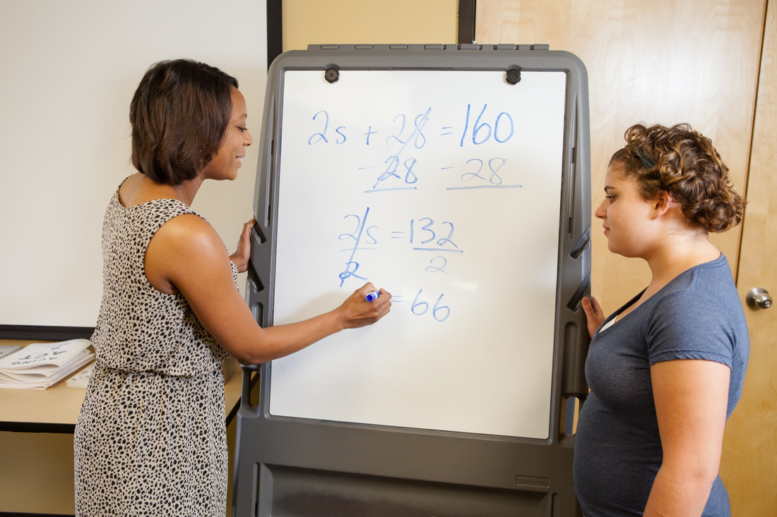
ACT® MATH

Slide 15
ACT® Math Quick Facts:
1
60 minutes for 60 questions
2
Five answer choices
3
Many easy questions will be at the beginning, and many difficult questions will come towards the end.
4
Formulas will not be given
Notes:
HERE ARE YOUR QUICK MATH FACTS
1. You’ll get 60 minutes to answer 60 questions on a variety of typical high school math subjects.
2. Unlike other sections, Math contains 5 answer choices.
3. Many easy questions will be at the beginning and many difficult questions will come towards the end.
4. You will not be provided with any formulas. Look in your book for a list of the formulas and terms you need to know, and make notecards to study those.

Slide 16
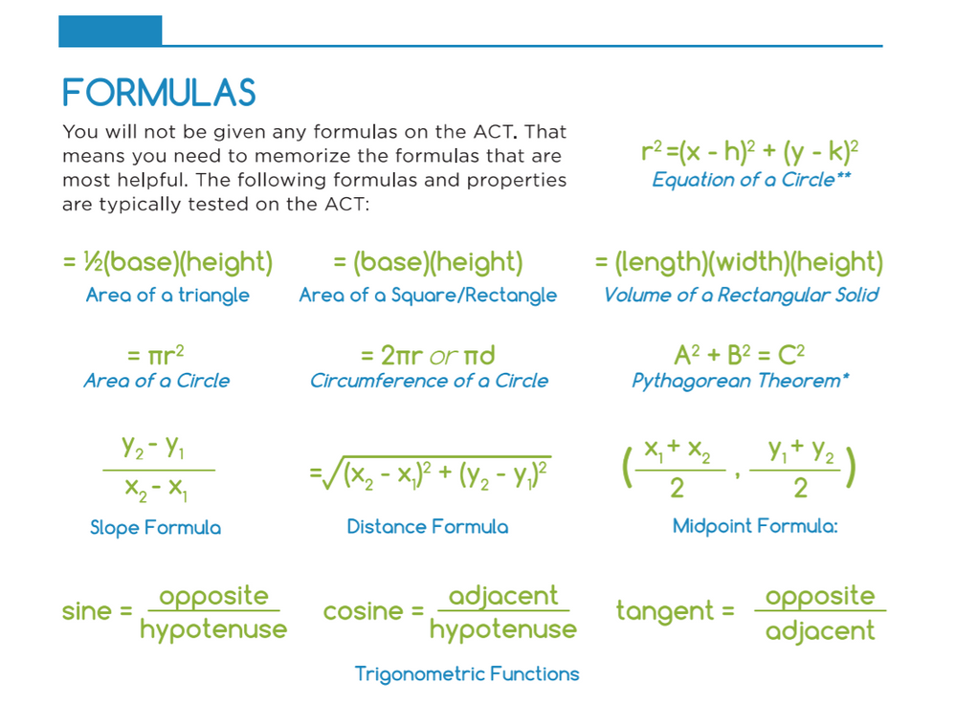
Notes:
Here are the math formulas that you will need to know.
1. You’ll get 60 minutes to answer 60 questions on a variety of typical high school math subjects.
2. Unlike other sections, Math contains 5 answer choices.
3. Many easy questions will be at the beginning and many difficult questions will come towards the end.
4. You will not be provided with any formulas. Look in your book for a list of the formulas and terms you need to know, and make notecards to study those.

Slide 17
ACT® Math Breakdown
**NOTE: The following is a sample of how the ACT® may present questions in each subject. The actual number may vary.
33 Algebra Questions
14 Pre-Algebra
10 Elementary Algebra/Algebra I
9 Intermediate Algebra/Algebra II
23 Geometry Questions
14 Plane Geometry
9 Coordinate Geometry
4 Trigonometry Questions
Notes:
Here is the ACT breakdown:
When did you take pre-algebra? Geometry? You might need to review some of those subjects.
This is an example of how the ACT may present questions in each subject. Remember, though, that the test you take may vary slightly in how many questions you get in each subject. For the true amount, be sure to review the ACT website for the percentage of questions in each subject.
Overall, focus the majority of your time on algebra and geometry. At least half of the questions will be from algebra, then the majority of the remaining questions will come from geometry. Focus on these first, as they are the majority of the test.

Slide 18
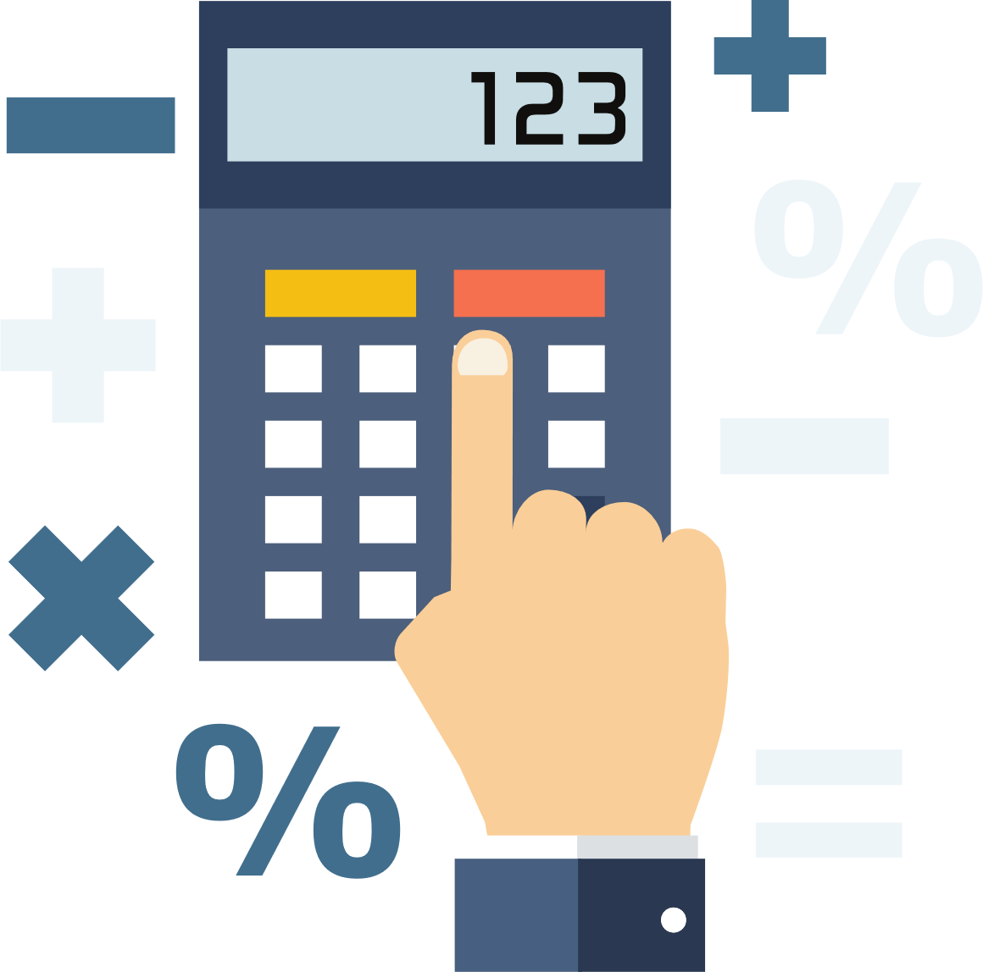
Calculator Quick Facts
1
Use your calculator as a tool, not a crutch
2
Make sure your calculator has fresh batteries
3
Don’t rely on the memory function
4
Make sure your calculator is allowed
Notes:
Everyone knows they need a calculator, right? If you are going to borrow one, try to get it early to practice with ahead of time. The worst thing you can do is buy a calculator the night before and break it open that morning. You need a calculator that you know how to use. Refresh your batteries before the test. There have been too many stories about students whose calculators have died on them.
Set up the problem on paper first to prevent confusion. Practice using the calculator to quickly work through basic math to save time, but not to stick in every single number and waste time.
Not all calculators are permitted when taking the ACT. Be sure to visit www.actstudent.org to make sure your calculator is permitted.

Slide 19
Key Term | Definition
Integer | Any number that is not a fraction
Real number | Any rational or irrational number
Rational number | An integer or a fraction
Prime number | A number divisible by only one and itself ZERO AND ONE ARE NEVER PRIME!!!
Remainder | The number left over when one integer is divided by another
Absolute Value | Distance from zero
Product | Multiply
Quotient | Divide
Sum | Add
Difference | Subtract
Consecutive | Integers in a sequence
Distinct | Non-repeats
Union | The collection of points the lie in sets A,B, or both
Intersection | The point where two straight lines meet
Rules of zero | 0÷a = 0 (if a does not equal 0) = 1 0(a) = 0 a÷0 = undefined
Notes:
You’ll need to be familiar with math terminology. Many questions will have these words. Review these definitions and rules before test day.

Slide 20
Shortcuts to ALGEBRA
1
Plugging-In
2
Using the Answers
Notes:
These 2 tricks will help you solve nearly ½ algebra questions on ACT, Less algebra= fewer mistakes
Remember, you DON’T get extra points on the ACT for doing the problem “the right way.” As long as you find the answer, the ACT never asks how you got it.
less Algebra = less time and less mistakes!
Here are 2 strategies – PLUGGING IN YOUR OWN NUMBER and USING THE ANSWERS

Slide 21
Plugging-In
Use this strategy when there are variables in the problem and answer choices.
Notes:
Plug in your own numbers whenever possible. When you see variables in the problem and the answer choices, you can rely on this strategy.
Basically we are going to pick our own numbers and stick them into the problem and answers to see which one matches.
Now when you get to choose what number to plug in, choose good numbers! There are some numbers you would not want to use. Which answers do you think those would be? (0 & 1) – Maybe have them write down their answer on white board.
Also, be sure to use different numbers for each of the variables. Using the same numbers can cause you to have multiple correct answers.

Slide 22
1ˢᵗ RULE OF WORD PROBLEMS:
FIND THE QUESTION MARK!!!

Slide 23
EXAMPLE
If w hats cost z dollars, then how many hats could you buy with $100?
A. 100/wz
B. 100w/z
C. 100/w
D. wz
E. 100wz
Notes:
Correct answer: B

Slide 24
EXAMPLE
If the sum of three consecutive odd integers is p, then in terms of p, what is the greatest of these three integers?
A. (p-6)/3
B. (p-3)/3
C. p/3
D. (p+3)/3
E. (p+6)/3
Notes:
Correct Answer: E

Slide 25
Using the Answer
Use this strategy when there are numbers in the answer choices.
Notes:
Use PITA when there are numbers in the answer choices or you feel the strong urge to write out a long algebraic expression!
Plugging in the answer choices allows us to work the problem backwards to solve easy questions quickly and to turn difficult questions into easy ones! This could be the most useful tactic we go over today but it can be difficult to identify the problems where this tactic can be used.

Slide 26
EXAMPLE
Marc is half as old as Tony and three times as old as Ben. If the sum of their ages is 40, how old is Marc?
A. 3
B. 6
C. 12
D. 18
E. 24
Notes:
Correct Answer: C

Slide 27
EXAMPLE
For 2 consecutive integers, the result of adding the smaller integer and triple the larger integer is 79. What are the two integers?
A. 18, 19
B. 19, 20
C. 20, 21
D. 26, 27
E. 39, 40
Notes:
Correct Answer: B

Slide 28
Geometry
1
Most shapes will be drawn to scale.
2
Use logic to solve geometry problems.
3
When a diagram is not given, draw it.
4
Study your formulas!
Notes:
Most shapes are drawn to scale. If you look at number 30 of the Preparing for the ACT booklet, you see a paragraph written above the figure. The paragraph is explaining what is drawn on the picture. Try jumping straight to the question. If you can answer the question based on the shape, you can save time not having to read every word in the paragraph.
Many times you can look at a figure and use logic to solve the problem instead of using formulas.
Always draw a diagram if there is not one given. Working out geometry problems in your head can be confusing. Draw the figure or diagram so that you have a physical representation of the information given.
Be sure to study your formulas! They won’t be given on the ACT.

Slide 29
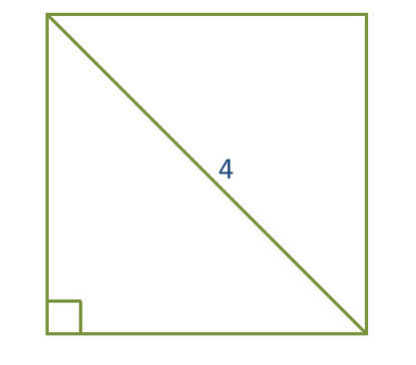
EXAMPLE
Figure DEFG is a square. If EG= 4, what is the area of the square?
A. 4
B. 4√2
C. 8
D. 16
E. 32
Notes:
Correct Answer: C

Slide 30
EXAMPLE
In the picture above, ABCD is a rectangle. If the area of triangle ABE is 40, what is the area of the rectangle?
A. 20
B. 40
C. 48
D. 80
E. 112
B
C
8
40
A
D
E
4
Notes:
Correct Answer: E

Slide 31
EXAMPLE
In the picture above, ABCD is a rectangle. If the area of triangle ABE is 40, what is the area of the rectangle?
A. 20
B. 40
C. 48
D. 80
E. 112
B
C
8
40
A
D
E
4
Notes:
This is another example of using logic instead of formulas to solve the problem.

Slide 32
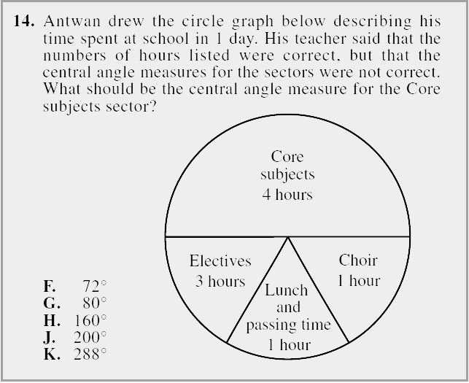
EXAMPLE
Notes:
Correct Answer: H

Slide 33
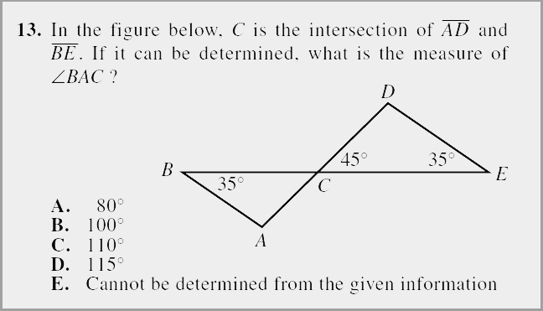
EXAMPLE
Notes:
Correct Answer: B

Slide 34
EXAMPLE
Common Question Types
In the school cafeteria, students choose their lunch from 3 sandwiches, 3 soups, 4 salads, and 2 drinks. How many different lunches are possible for a student who chooses exactly 1 sandwich, 1 soup, 1 salad, and 1 drink?
A. 2
B. 4
C. 12
D. 36
E. 72
Notes:
Correct Answer: E

Slide 35
EXAMPLE
Common Question Types
Toby wants to find the volume of a solid toy soldier. He fills a rectangular container 8 cm long, 6 cm wide, and 10 cm high with water to a depth of 4 cm. Toby totally submerges the toy soldier in the water. The height of the water with the submerged toy soldier is 6.6 cm. Which of the following is closest to the volume, in cubic centimeters, of the toy soldier?
A. 125
B. 156
C. 192
D. 208
E. 317
Notes:
Correct Answer: A

Slide 36
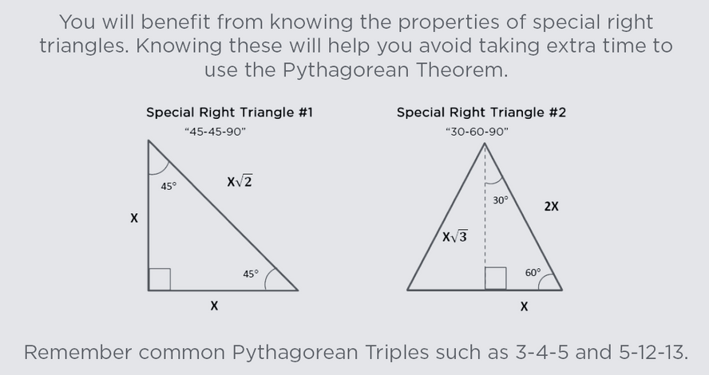
Triangles
Notes:
Correct Answer: A

Slide 37
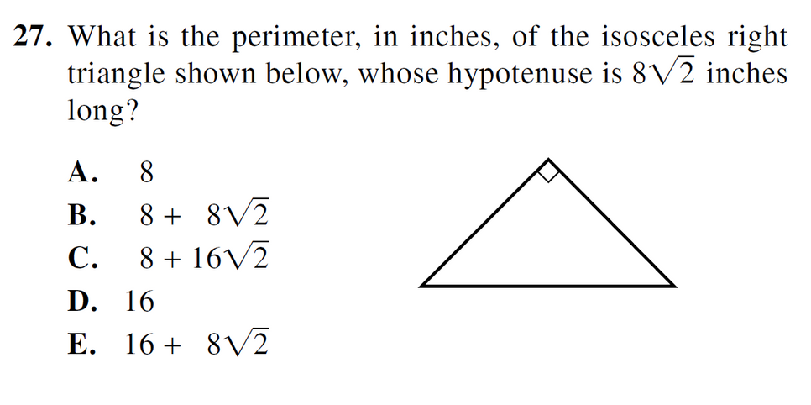
Triangles
Notes:
Correct Answer: A

Slide 38
SOHCAHTOA
Sine= Opposite/Hypotenuse
Cosine= Adjacent/Hypotenuse
Tangent= Opposite/Adjacent
θ
Adjacent
Hypotenuse
Opposite
Notes:
Correct Answer: A

Slide 39
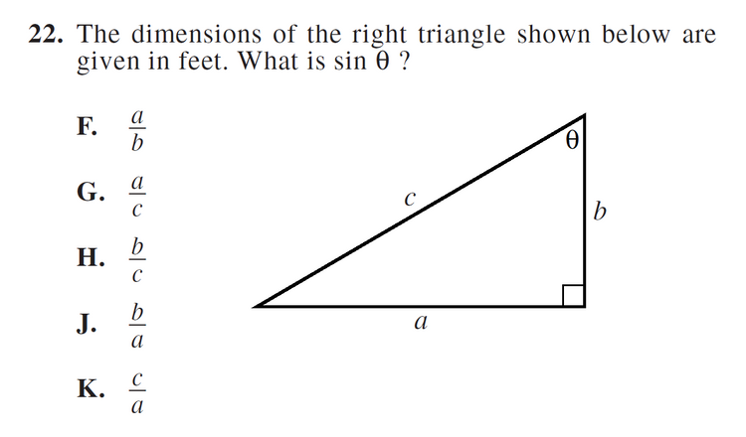
SOHCAHTOA
Sine= Opposite/Hypotenuse
Cosine= Adjacent/Hypotenuse
Tangent= Opposite/Adjacent
Notes:
Correct Answer: A

Slide 40
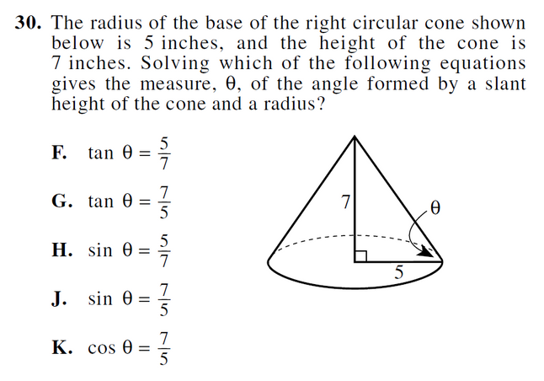
SOHCAHTOA
Sine= Opposite/Hypotenuse
Cosine= Adjacent/Hypotenuse
Tangent= Opposite/Adjacent
Notes:
Correct Answer: A

Slide 41
EXAMPLE
Walter recently vacationed in Paris. While there, he visited the Louvre, a famous art museum. Afterward, he took a 3.7-kilometer cab ride from the Louvre to the Eiffel Tower. A tour guide named Amélie informed him that 2.5 million rivets were used to build the tower, which stands 320 meters tall.
At a certain point, the angle of elevations formed by the level ground and the line from that point to the top of the Eiffel Tower is 70°. Which of the following expressions is equal to the distance, in meters, between that point and the center of the base of the tower?
F. 320 cos 70°
G. 320 sin 70°
H. 320 tan 70°
I. 320
sin 70°
J. 320
tan 70°
Notes:
Correct Answer: K

Slide 42
EXAMPLE
Difficult Questions
The sum of 2 positive numbers is 151. The lesser number is 19 more than the square root of the greater number. What is the value of the greater number minus the lesser number?
A. 19
B. 66
C. 85
D. 91
E. 121
Notes:
Correct Answer: K

Slide 43
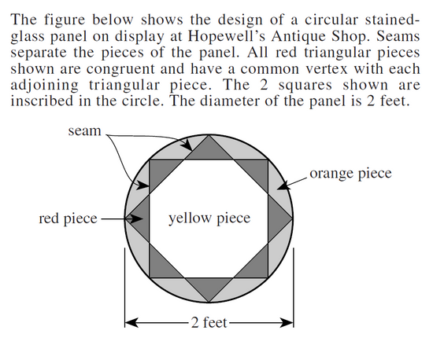
EXAMPLE
Difficult Questions
What is the area of the stained-glass panel, to the nearest 0.1 square foot?
A. 03.1
B. 04.0
C. 06.2
D. 08.0
E. 12.6

Slide 44

ACT® READING

Slide 45
ACT® Reading Quick Facts:
1
4 passages
2
40 questions in 35 minutes
3
10 questions per passage
This test is designed so that time is an issue!
Notes:
You will read 4 passages and answer 40 questions in 35 minutes. This means, you have approximately 9 minutes per passage.

Slide 46
Types of Reading Passages
1
Literary Narrative or Prose Fiction
2
Social Sciences
3
Humanities
More Straightforward
4
Natural Sciences
Notes:
These will be four type of reading passages on the reading test.
Social Sciences, Humanities, and Natural Sciences tend to be more straightforward. Do not take the passages as they come. Instead, skip the Prose Fiction/Literary Narrative passage and come back to it after you finish the other three. Remember, every question is worth the same amount.

Slide 47
It’s an open book test!
You never have to remember what you read!
Notes:
Because the passage is always in front of you, you should not waste time and brain energy trying to remember the passage.
If your English teacher gives you a book to read over the weekend and tests you on that book on Monday, what is she/he testing you on? They are testing you on how much you can REMEMBER. This is a different skill than on the ACT, where the passage is always in front of you- more like an open book test.
Open book tests ask different skills of you, they ask you to read critically rather than just read every word as it is given and then answer the questions based on what you can remember. You need to be able to find what they ask you in the shortest time possible.

Slide 48
ALWAYS
Read the Blurb!
Notes:
How many of you have ever skipped the blurb when doing the ACT Reading? It seems to make sense, since you have such a short amount of time, but resist the urge to skip it. You will find that some of the time, you can get a great deal of information from those few sentences.
This is the few sentences before the passage starts that is in a different font from the rest of the passage. Read the blurb from Passage II of Preparing for the ACT. What information can we gather from these few short sentences?

Slide 49
What is the
MAIN IDEA?
Notes:
For the three more straightforward passages, the first thing you want to zero in on is the author’s MAIN IDEA. Why did she/he write this article?

Slide 50

Non-Fiction Passages
1
Read the blurb.
2
Find the thesis statement.
3
Dissect the thesis statement to understand the overall theme of the passage
Notes:
There is an official method for reading and analyzing a large amount of information in a short amount of time, and it is called speed reading. Especially if you are not a very fast reader, this method can be applied to any passage or article that you need to read in a short amount of time. This skill of reading and analyzing quickly will be important when you get to college and you have lots to read and very little time to do it.
We had a student who was great in math and science, but his reading score was bringing his ACT composite score down. He said this method helped him to figure out how to most effectively spend his short time (9 minutes) on the ACT Reading.

Slide 51
Fiction Passage
1
Read the blurb.
2
Find the proper nouns.
3
Read the dialogue.
4
Watch out for figurative language.
Notes:
There is an official method for reading and analyzing a large amount of information in a short amount of time, and it is called speed reading. Especially if you are not a very fast reader, this method can be applied to any passage or article that you need to read in a short amount of time. This skill of reading and analyzing quickly will be important when you get to college and you have lots to read and very little time to do it.
We had a student who was great in math and science, but his reading score was bringing his ACT composite score down. He said this method helped him to figure out how to most effectively spend his short time (9 minutes) on the ACT Reading.

Slide 52
Answer the questions in easy to hard order
Notes:
Don’t take the questions in the order they are given. Instead, answer the easy questions first and move gradually into the most difficult questions.

Slide 53
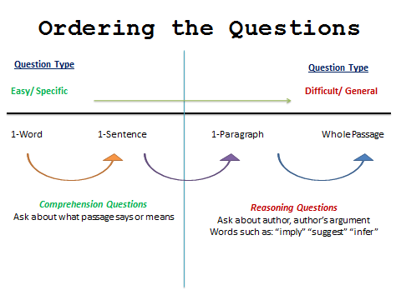
Notes:
Don’t take the questions in the order they are given. Instead, answer the easy questions first and move gradually into the most difficult questions.

Slide 54
Learn how to find trap answers
“Ms. Nelson came to class this morning with wet hair.”
What can be inferred from the preceding statement?
A. She ran through the sprinklers
B. She was sweating from the gym
C. She showered before class
D. Her hair is not dry
Notes:
Correct Answer: D

Slide 55
Ordering the Questions Drill
___ According to the passage in line 9, “spell” most nearly means
___ In lines 10–22, the author notes that a “hard day’s work” does all
of the following EXCEPT
___ In lines 31–33, the author mentions the loss of Alice’s innocence in
order to
___ The author’s tone in lines 31–34 could most accurately be
characterized as
___ In line 7, “harassing” most closely means
___ The author suggest that athletes
___ The “Good Walk Spoiled” (line 32) most likely refers to a
___ In paragraph 4, the author argues that dancing helps the elderly
of America by
Notes:
Don’t take the questions in the order they are given. Instead, answer the easy questions first and move gradually into the most difficult questions.

Slide 56
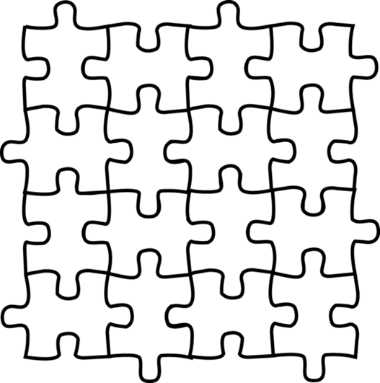
Correct Answer Puzzle Fit
Notes:
Don’t take the questions in the order they are given. Instead, answer the easy questions first and move gradually into the most difficult questions.

Slide 57

ACT® SCIENCE
Notes:
The Science section will be the last section on the ACT so you WILL be tired! So this is how you will feel on test day!
An important way to raise your ACT Science score is to practice your endurance for taking the whole LONG test over one or two timed practices. Practicing the full ACT will help with getting through to the science section with enough energy.

Slide 58
ACT® Science Quick Facts:
1
6 or 7 passages
2
40 Questions in 35 minutes
3
5-7 questions per passage
This test is designed so that time is an issue!
Notes:
It’s important to understand that the ACT SCIENCE test, doesn’t actually test much science. Rather, it is a reading comprehension exam where science is the subject. Again, these problems are structured such that students struggle with time! So if you can do Reading, you can do Science!
How many passages did you have on the Reading section? 4. How many do you have in the Science section? Either 6 or 7.
The science test will consist of 6 - 7 passages that will each be followed by 5-7 questions. The passages will cover content from biology, chemistry and physical sciences. They will vary in terms of organization and difficulty. You will have 35 minutes to answer 40 questions!

Slide 59
ACT® Science is not a science test
You don’t have to know much science content at all to do well on the ACT Science Test!
Notes:
Remember that this is not a true science test. Rather, it is a reading comprehension test where science is the subject. This can be challenging for many students, because you have never really seen a test quite like it before. It’s nothing like the tests you might have in your biology class, for example.
The good news is, if you can do Reading, you can do Science!

Slide 60
Identify the Passage Type
Notes:
Where as in Reading they told you exactly what type of passage you were looking at, in Science you need to be able to identify which passage type you are tackling.

Slide 61
Three Types of Passages
1
Charts & Graphs (Data Representation)
2
Experiments (Research Summaries)
3
Conflicting Scientists (Conflicting Viewpoints)
Notes:
The charts and graphs passages are the most straightforward. The answers to the questions will typically be found by reading and comprehending a chart or graph. These are typically the easiest for students, and we recommend doing these first.
The experiments passages are a little more difficult. They are a hybrid of explaining the experiment and presenting the results. Do these second. They will typically have words such as “Experiment 1/Experiment 2” or “Study 1/Study 2”
There is always one conflicting scientists passage. Save this for last, as it is the most time consuming and most difficult. This passage will include multiple individuals proposing conflicting viewpoints on one scientific idea. They can be recognized by terms such as “Scientist 1/Scientist 2” or “Hypothesis 1/Hypothesis 2”
Go through the Science section of the Preparing for the ACT booklet and identify each passage type.

Slide 62
Substitute to Simplify
Notes:
The best skill you can cultivate to improve your score on the ACT Science is being able to look past the difficult vocabulary to analyze the passage or graph. One strategy is to physically cross out words you don’t know and replace them with a word or phrase that makes sense to you.
For example, in the previous example, does anyone know what the words Geospiza fortis and Geospiza fuliginosa are? No, and you don’t need to know those latin terms. Everytime you see Geospiza fortis cross it out and replace it with hawks, and every time you see Geospiza fuliginosa cross it out and replace it with the word blue jays. Be easy on yourself and make the test as easy to digest as possible.

Slide 63
Focus on the Graphs
Notes:
After you get a feel for the experiment (or right off the bat for a “Charts/Graphs” passage) jump into understanding the graphs before you go to the questions.

Slide 64
Questions to Ask about Charts/Graphs
1
What are the variables? (temperature, number of plants, pressure, mph)
2
How are they measured? (grams, quarts, percentages)
3
What does the graph tell you?
Notes:
Practice analyzing graphs until the answers to these questions come to you immediately.
Use several examples from the Preparing for the ACT booklet to demonstrate how to analyze different types of graphs. Figures 1 and 2 from Passage III are good graphs to review.

Slide 65
Questions to Ask about Charts/Graphs
Weight
Time
Notes:
Practice analyzing graphs until the answers to these questions come to you immediately.
Use several examples from the Preparing for the ACT booklet to demonstrate how to analyze different types of graphs. Figures 1 and 2 from Passage III are good graphs to review.

Slide 66
Questions to Ask about Charts/Graphs
1
What are the variables? (temperature, number of plants, pressure, mph)
2
How are they measured? (grams, quarts, percentages)
3
What does the graph tell you?
Notes:
Practice analyzing graphs until the answers to these questions come to you immediately.
Use several examples from the Preparing for the ACT booklet to demonstrate how to analyze different types of graphs. Figures 1 and 2 from Passage III are good graphs to review.

Slide 67
Questions to Ask about Charts/Graphs
Weight (kg)
Time (min)
Notes:
Practice analyzing graphs until the answers to these questions come to you immediately.
Use several examples from the Preparing for the ACT booklet to demonstrate how to analyze different types of graphs. Figures 1 and 2 from Passage III are good graphs to review.

Slide 68
Questions to Ask about Charts/Graphs
Weight (kg)
Color
Notes:
Practice analyzing graphs until the answers to these questions come to you immediately.
Use several examples from the Preparing for the ACT booklet to demonstrate how to analyze different types of graphs. Figures 1 and 2 from Passage III are good graphs to review.

Slide 69
Questions to Ask about Charts/Graphs
1
What are the variables? (temperature, number of plants, pressure, mph)
2
How are they measured? (grams, quarts, percentages)
3
What does the graph tell you?
Notes:
Practice analyzing graphs until the answers to these questions come to you immediately.
Use several examples from the Preparing for the ACT booklet to demonstrate how to analyze different types of graphs. Figures 1 and 2 from Passage III are good graphs to review.

Slide 70
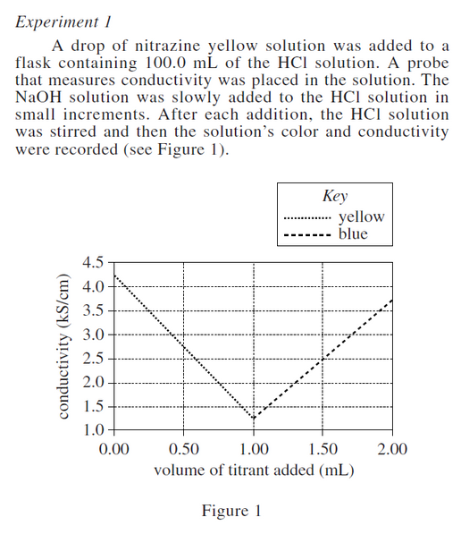
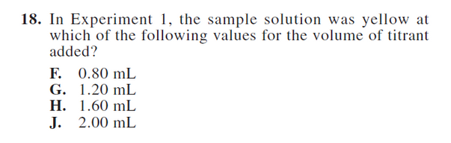
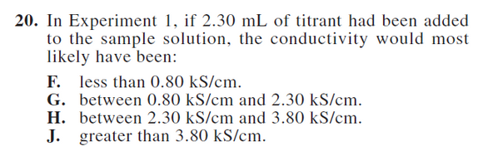
EXAMPLE
Notes:
Practice analyzing graphs until the answers to these questions come to you immediately.
Use several examples from the Preparing for the ACT booklet to demonstrate how to analyze different types of graphs. Figures 1 and 2 from Passage III are good graphs to review.

Slide 71
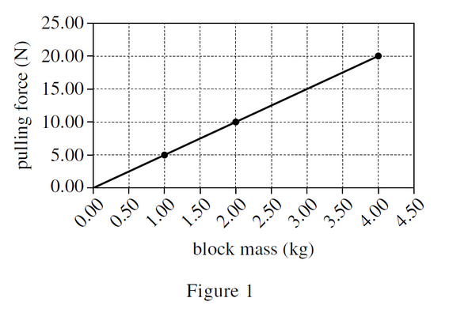
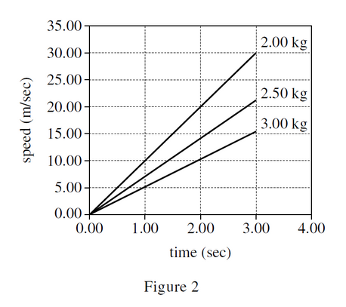
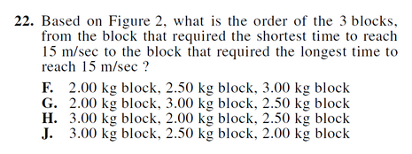
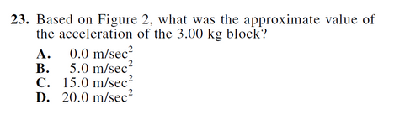
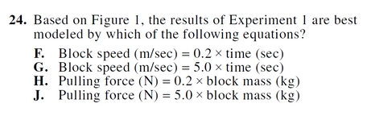
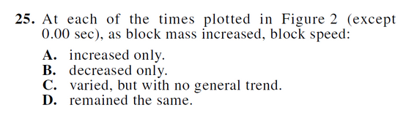
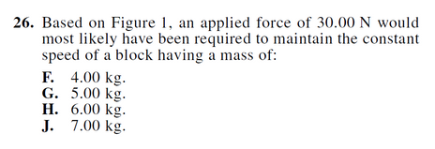
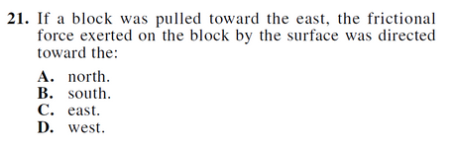
EXAMPLE
Notes:
Practice analyzing graphs until the answers to these questions come to you immediately.
Use several examples from the Preparing for the ACT booklet to demonstrate how to analyze different types of graphs. Figures 1 and 2 from Passage III are good graphs to review.

Slide 72
Answer the Questions Strategically
Notes:
Have students look at Passage II and determine which questions are easy, medium, and hard based off of the strategy we covered in the reading section.

Slide 73
Types of Questions
Easy Questions: Fetch the Answer
    These questions ask directly about the passage, usually requiring you to read a chart or graph.
    They usually come first, so answer them right after analyzing the information given.
Notes:
Number 15, Passage III is an example of an easy question. It asks you to look at the graph and fetch the answer from 8,000 years.

Slide 74
Types of Questions
Medium Questions: Read and Reason
    These questions ask you to slightly analyze the information presented. We recommend doing
these second.
    You may have to predict a trend on a chart or graph or further analyze an experiment.
Notes:
Number 16 Passage III is an example of a medium question. It asks you to predict information based on trends.

Slide 75
Types of Questions
Hard Questions: Big Picture
    These questions ask about the passage as a whole. Typically, you want to save these for last.
    By the time you answer these questions, you will have analyzed the information multiple times and hopefully have a very good idea about the general purpose of the passage.
Notes:
Number 20, passage III is a hard question asking about the entire passage.

Slide 76
ACT® ENGLISH

Slide 77
ACT® English Quick Facts:
1
45 minutes for 75 questions
2
Questions will come from 5 passages
3
Questions will test you on punctuation, grammar, style, sentence structure, and organization/clarity
Notes:
You will have 45 minutes to answer 75 questions that will come from 5 passages.
The questions will measure your abilities in grammar, organization and style, as well as your ability to strengthen or revise parts of each passage.

Slide 78
ACT® English Rules:
Comma Splices
A comma by itself is not strong enough to split up 2 independent clauses
      Ex. “I’m going to the store, I’m going to buy some ham.” ☹
Notes:
You will have 45 minutes to answer 75 questions that will come from 5 passages.
The questions will measure your abilities in grammar, organization and style, as well as your ability to strengthen or revise parts of each passage.

Slide 79
ACT® English Rules:
Commas
1. You don’t need a comma between what you’re doing and where you’re doing it
      Ex. “I’m cooking, in the kitchen.”☹
      Ex. “I’m playing basketball, in the gym.”☹
2. You don’t need a comma if you’re only listing two things
      Ex. “Milk, and cereal…”☹
      Ex. “Macaroni, and cheese…”☹
3. You don’t need a comma between your subject and your verb (unless there is a prepositional phrase)
      Ex. “Frank, played PlayStation all day long.”☹
      Ex. “Kenya, braided her little sister’s hair.”☹
4. You don’t need a comma between an adjective/quantity and the noun that it’s describing (or an adverb from the verb that it’s describing)
      Ex. “Look at the happy, puppy.”☹
      Ex. “I just ate two, apples.”☹
      Ex. “I slowly, walked up the stairs.” ☹
5. You don’t need a comma between someone’s job title and their name
      Ex. “American astronaut, Neil Armstrong was the first man on the moon.”☹

Slide 80
EXAMPLE
Often, my brother and I, joined our mother on her adventures into tidal lands.
F. NO CHANGE
G. brother, and I,
H. brother, and I
J. brother and I
Notes:
Correct Answer: J

Slide 81
ACT® English Rules:
Semicolons (Your Best Friend)
You have to have a complete thought on both sides of the semicolon. If an answer choice doesn’t have an independent clause on both sides, it’s not right.
      Ex. “It’s cold outside; colder than it’s ever been.”
Notes:
You will have 45 minutes to answer 75 questions that will come from 5 passages.
The questions will measure your abilities in grammar, organization and style, as well as your ability to strengthen or revise parts of each passage.

Slide 82
EXAMPLE
Built upon second-century foundations. St. Peter’s features a dome designed by the artist and architect Michelangelo.
F. NO CHANGE
G. foundations,
H. foundations:
J. foundations;
Notes:
Correct Answer: G

Slide 83
EXAMPLE
At the very low tides of the full moon, when almost all the water was sucked away, we found the hideaways where crabs, snails, starfish, and sea urchins hid.
A. NO CHANGE
B. away. Then we
C. away. We
D. away; we
Notes:
Correct Answer: A

Slide 84
ACT® English Rules:
Colons
THEY HAVE NOTHING TO DO WITH MAKING A LIST!
You AT LEAST need a complete thought BEFORE the colon.
      Ex. “You would’ve gotten a perfect score on the ACT had it not been for one subject: math.”
      Ex: “I’m going to the store to get the following items: milk, cheese, eggs, bacon, and sausage.”

Slide 85
ACT® English Rules:
Dashes
Used for an interjection in thought that is not absolutely necessary for the sentence
      Ex. “Jay Z was my favorite rapper when I was growing up –he still is– and I bought tickets to his concert this fall.”
      Ex. “I ride this trail nearly every day– not on a bike, but on Luigi.”

Slide 86
EXAMPLE
I ride this trail nearly every day ─ not on a bike, but on “Luigi.”
F. NO CHANGE
G. day; not on a bike
H. day not on a bike
J. day, not on a bike;
Notes:
Correct Answer: F

Slide 87
ACT® English Rules:
Collective Nouns
They represent something plural but they’re treated as if they were singular. (ex. team, class, equipment, everyone, each)
      Ex. “Each one of my family members is/are coming to Thanksgiving.”
      Ex. “My equipment is/are dry.”

Slide 88
ACT® English Rules:
Cut the Fat
All of the extra information that separates the subject from the verb is called the prepositional phrase. When you cut the “fat” and put the subject and verb together, it’s easier to see whether or not they agree.
      Ex. “The happy pack of dogs run/runs through the yard.”

Slide 89
ACT® English Rules:
Misplaced Modifiers
If the modifier is in the wrong place it makes the sentence sound crazy.
      Ex. “I was walking down the street and I saw a gold man’s watch.”

Slide 90
ACT® English Rules:
Parallel Structure
Your verb tenses, voice, etc. need to be consistent.
      Ex. “Last weekend in New Orleans, I listened to music, danced at a club, and drinking at a bar.”☹
      Ex. “I went to Barbados last year. I had a lot of fun. I ate a lot of really good food. I went on a jeep tour around the island. I went on a cruise ship and he even went swimming in the ocean.”

Slide 91
ACT® English Rules:
Ambiguity
You cannot use a pronoun in the place of a subject if it’s not clear what/whom you’re referring to.
      Ex. “Susan and LaToya are going to her house after the workshop.”

Slide 92
EXAMPLE
The county cleared this path and paved it with packed gravel, so they would have a peaceful place to hike and bike.
A. NO CHANGE
B. knowing they
C. that they
D. people
Notes:
Correct Answer: D

Slide 93
ACT® English Rules:
Redundancy
Redundancy is when you’re repeating yourself unnecessarily.
      Ex. “My legs are sore because I’ve been jumping up and down all day.”☹
      Ex. “I was zig-zagging from left to right.”☹
      Ex. “I’m going to kill him to death.”☹

Slide 94
ACT® English Rules:
Run-on Sentences
There should be a pause but there’s not one.
      Ex. “I can’t stand that girl she gets on my nerves.”

Slide 95
EXAMPLE
At 2 p.m., on October 27, 1904; thousands of New York City residents poured into the streets of Manhattan.
F. NO CHANGE
G. 2 p.m. on October 27, 1904, thousands
H. 2 p.m., on October 27, 1904; thousands
J. 2 p.m. on October 27, 1904, thousands,
Notes:
Correct Answer: G

Slide 96
EXAMPLE
The few times that I’ve helped a friend with yard work has given me the joy of touching the soil with an open palm, of patting down the berm around a newly transplanted sapling.
    NO CHANGE
    have given
    has gave
    have gave
Notes:
Correct Answer: B

Slide 97
English Tips
1
The shortest answer is usually right if it makes sense!
2
Don’t be afraid to select DELETE the Underlined Portion or NO CHANGE as the answer.
3
Be sure to review rules for punctuation and grammar.
Notes:
The English section likes straightforward, newspaper-type writing. Unlike writing essays in an English class, when you add fluff to reach a page limit or word count, the ACT likes succinct writing. Typically, the shortest answer is right if it makes sense.
Don’t be afraid to choose DELETE THE UNDERLINED PORTION or NO CHANGE as the answer. Just because it is underlined doesn’t mean that there is an error or that it is even needed. These answers are correct just as often as the others.
Review your punctuation and grammar rules. Many questions will ask about pronoun-antecedent agreement, noun-verb agreement, who/whom, its/it’s, etc. Review these rules to ensure you can correctly answer these questions.

Slide 98


www.get2college.org
Notes:
98

